Slide 1
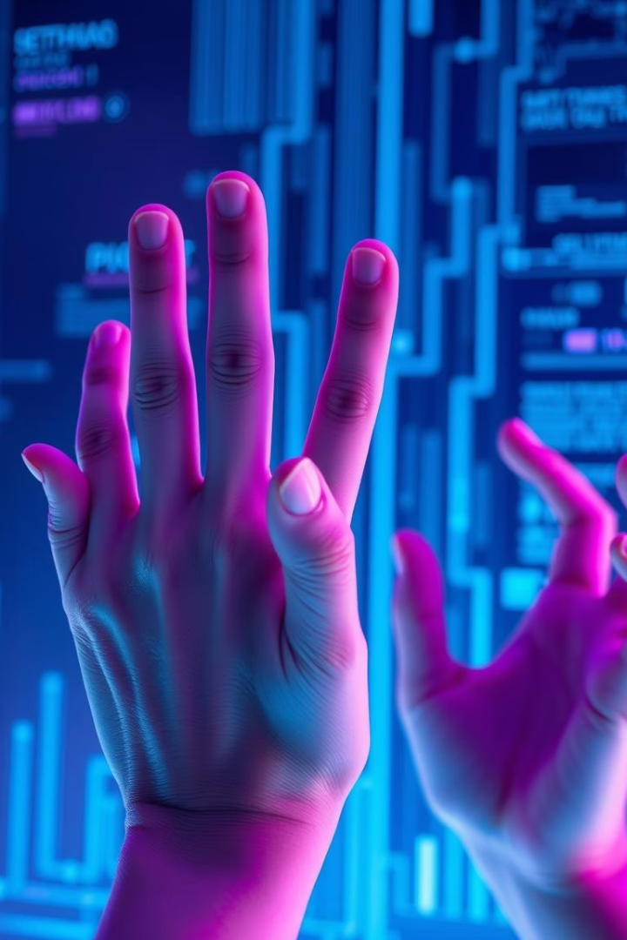
HANDSIGHT: Real-Time Gesture Recognition
Advanced gesture recognition using only a webcam

Slide 2
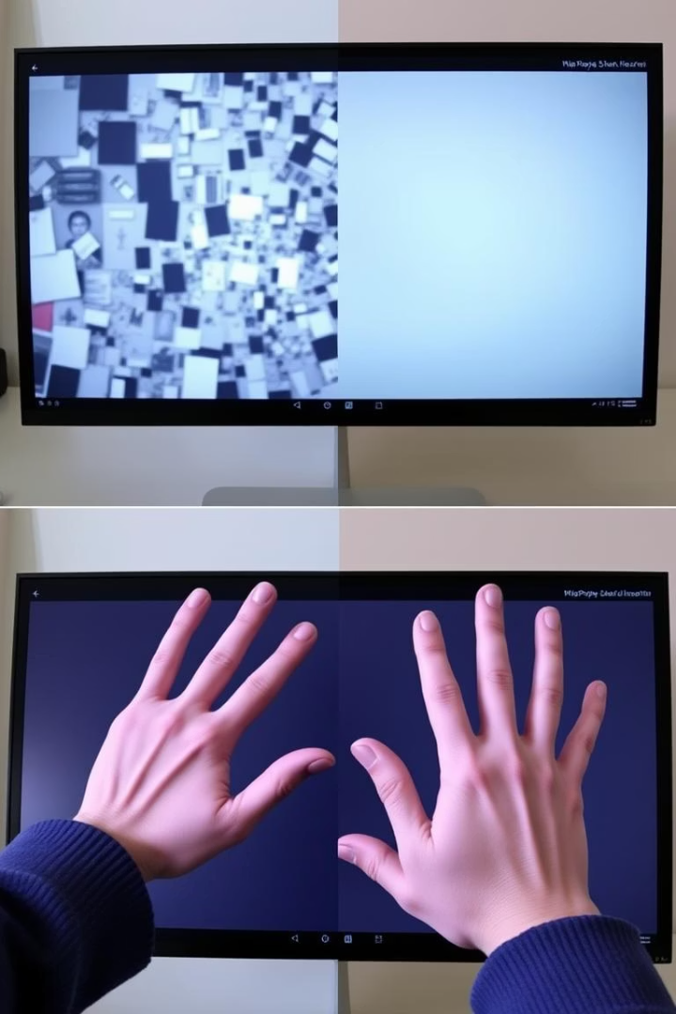



Why HANDSIGHT?
Cluttered backgrounds
Poor lighting
Struggles with inconsistent illumination
Most systems fail with real-world visual noise
Noisy inputs
MediaPipe hand landmarks overcome these challenges

Slide 3




The Vision Behind HANDSIGHT
Accessible
Real-time
Modest hardware
Only requires a standard webcam
Instant gesture recognition
Works on standard computers

Slide 4
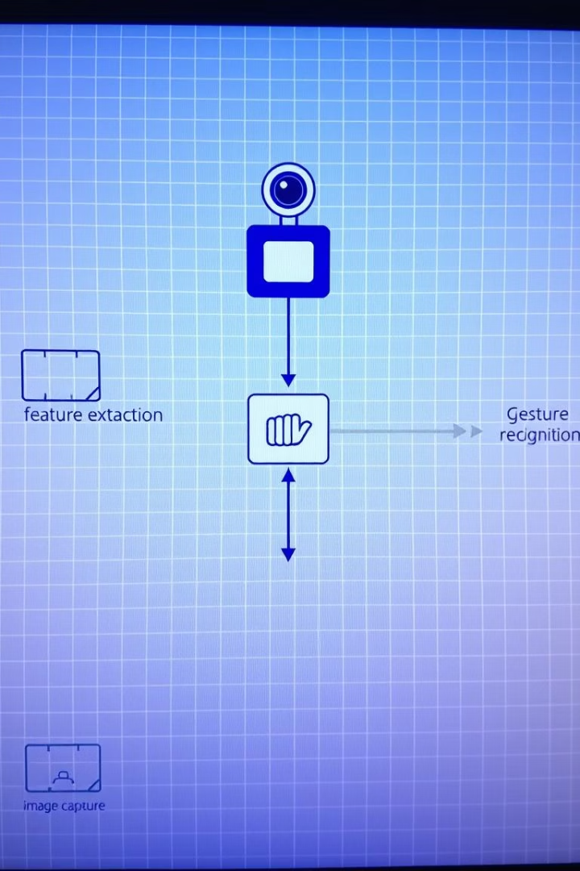




System Architecture
Webcam
Video input capture
MediaPipe
Hand landmark detection
Keypoints
3D coordinate extraction
Classifier
RF + CNN prediction

Slide 5
FFNN + Keypoints Fusion
FFNN
RandomForest
Soft Fusion
Processes gesture landmarks and ID
Analyzes 3D keypoints from CSV
Combines both outputs
Visual gesture id
Spatial relationship analysis
Boosts accuracy and robustness

Slide 6
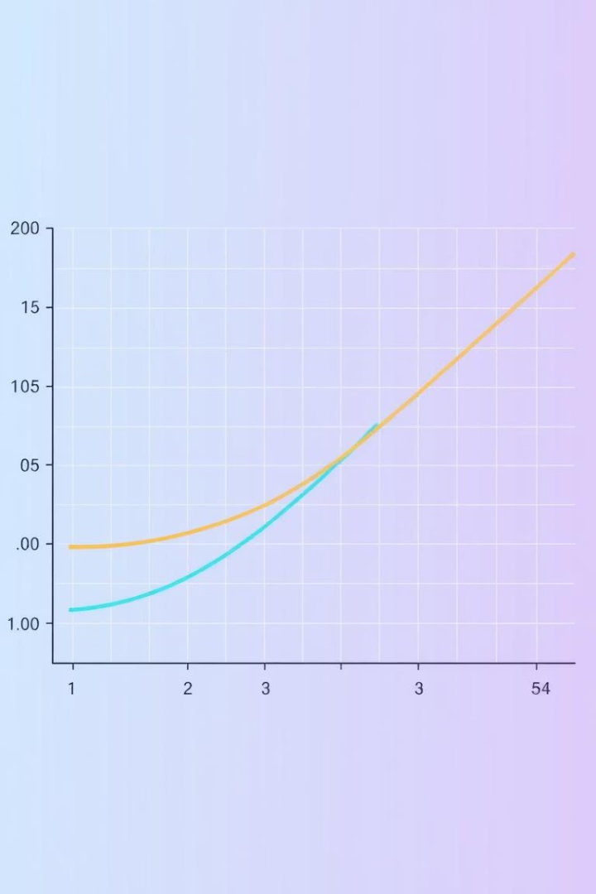
Model Training
Data Collection
Labeled gesture images and keypoint CSVs
Model Training
CNN on images, RF on 21×3 landmarks
Performance Tracking
Accuracy/loss over epochs

Slide 7
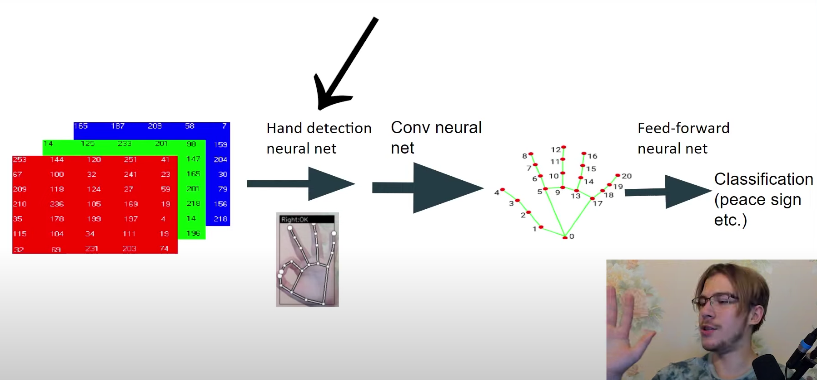
True Working in Project

Slide 8
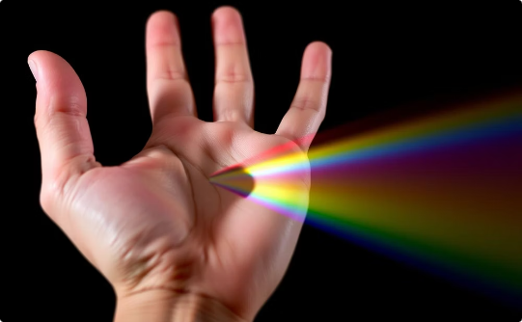
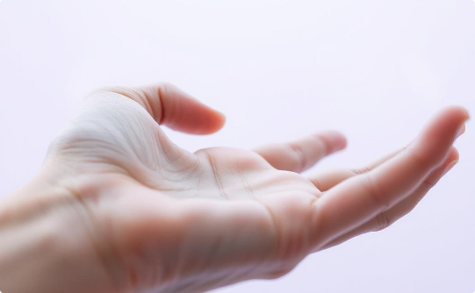
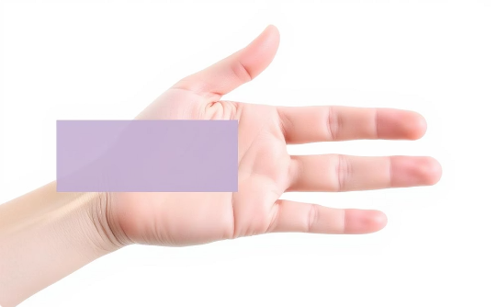
Data Augmentation Techniques
HSV Jitter
Gaussian Noise
Occlusion Masks
Color variance training
Improves noise resistance
Handles partial visibility

Slide 9








Real-Time Inference
Live Webcam
MediaPipe
Video input stream
Hand landmark detection
Display
Classifier
FPS overlay + gesture label
Gesture prediction

Slide 10
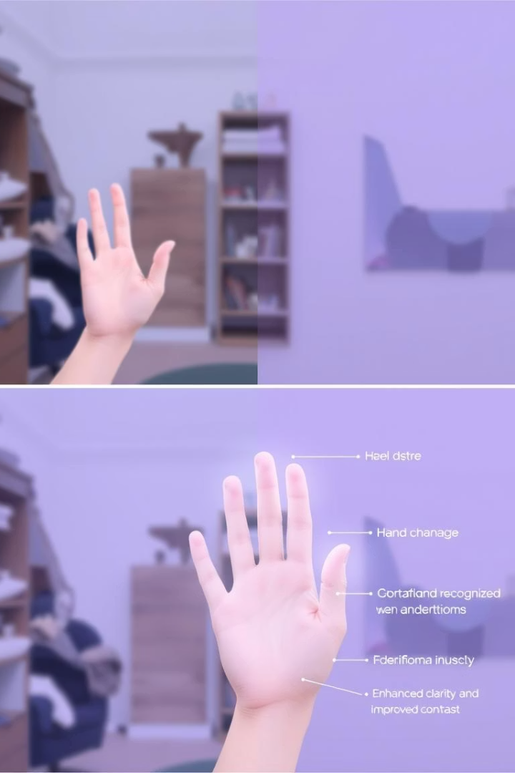
Real-World Problems Solved
Lighting Inconsistency
Works in varied illumination
Ambiguous Gestures
Distinguishes similar hand positions
Background Noise
Prevents overfitting to environments
CPU-Only Inference
No specialized hardware needed

Slide 11
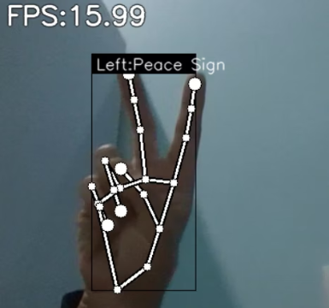
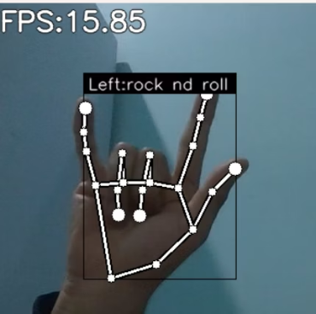
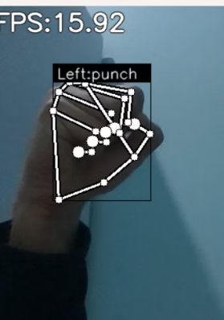
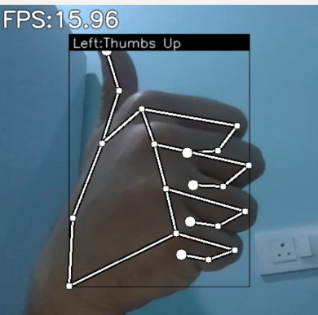
Visual From code

Slide 12
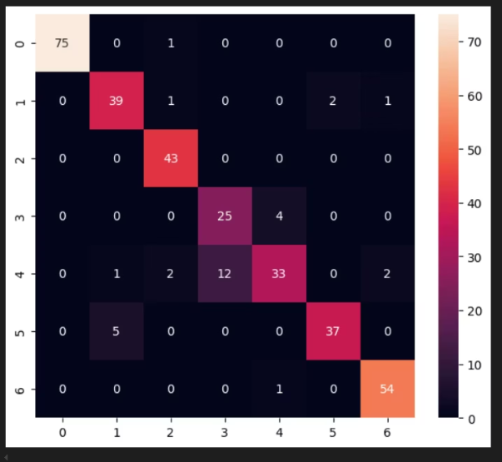
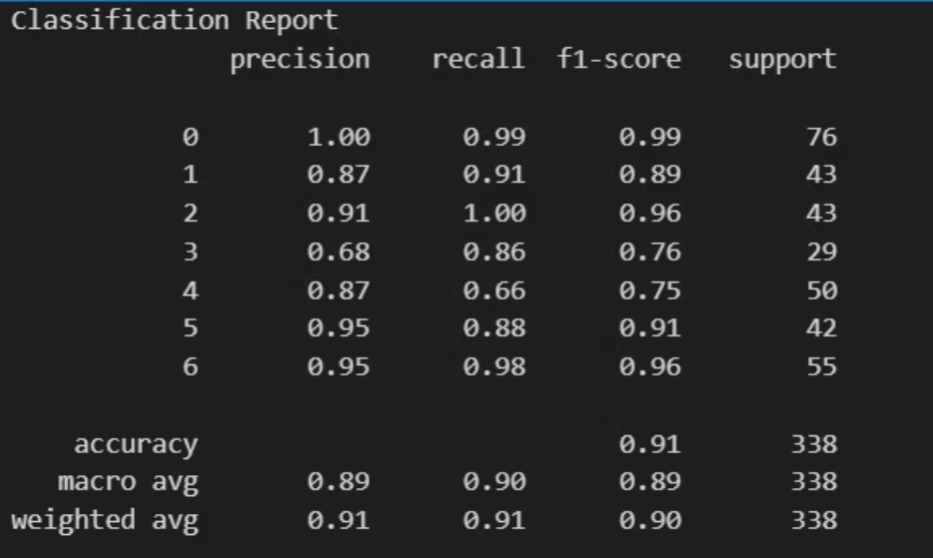
Confusion matrix
+

Slide 13
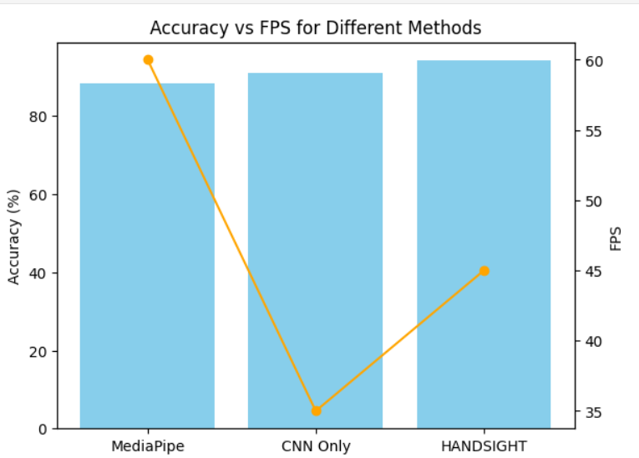
GRAPH(Accuracy and FPS)

Slide 14
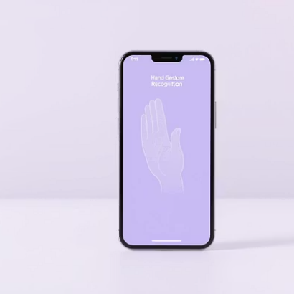
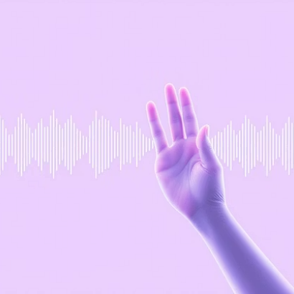
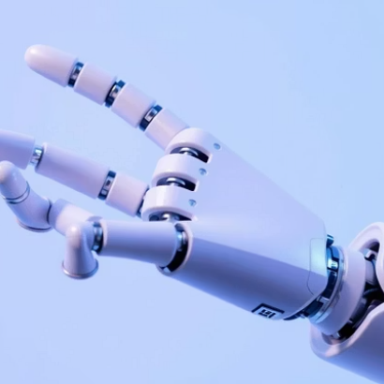
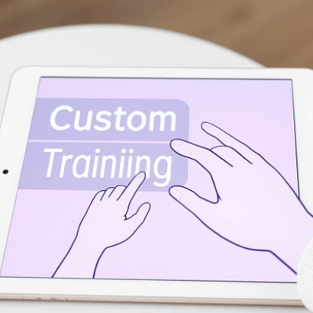
What's Next?
Expanding to mobile, voice+gesture fusion, robot control, and custom training UI

